Slide 1
CS422 Database systems
Distributed Transactions
Data-Intensive Applications and Systems (DIAS) Laboratory École Polytechnique Fédérale de Lausanne
“Too much agreement kills the chat.” – John Jay Chapman
Some slides adapted from:
Andy Pavlo
CS-322
Notes:
We have already discussed in detail the problems in executing transactions on a single maching
However as you can imagine your banking account is not stored solely in one machine ☺

Slide 2
Outline
Parallel architectures
Distributed transactions
Concurrency control
Commit
Replication
Eventual Consistency
Notes:
In this weeks lecture we will discuss
What kind of architectures we can have when we are starting to have multiple instance sharing and inevitable fighting for resources
Subsequently we will discuss about concurrency control and how we can make sure that the results of a distributed transaction is durable
Then how we can make sure that we are failsafe ;)
And finally during the last our in our otherside lecture we will discuss about eventual consistency or what you have probably heard about the “NoSQL” move…

Slide 3
Architectures for (Parallel) Databases
Shared Everything
Shared Memory
Shared Disk
Shared Nothing
Notes:
Here are the possible architectures for parallel databases.
The first one is the simplest one: essentially you have a machine in a single-box possibly with multiple sockets and cores sharing memory disk network.

Slide 4
Shared Memory
Nodes share both RAM and disk
Dozens to hundreds of processors
Easy to use and program
But very expensive to scale
(Cheaper) RDMA may change the picture
Notes:
* CPUs have access to common memory address space via a fast interconnect.
* Each processor has a global view of all the in-memory data structures
Each DBMS instance on a processor has to “know” about the other instances
Example: Oracle RAC -> network fabric to expose all the (shared) memory to all
SQL Server papers on this too

Slide 5
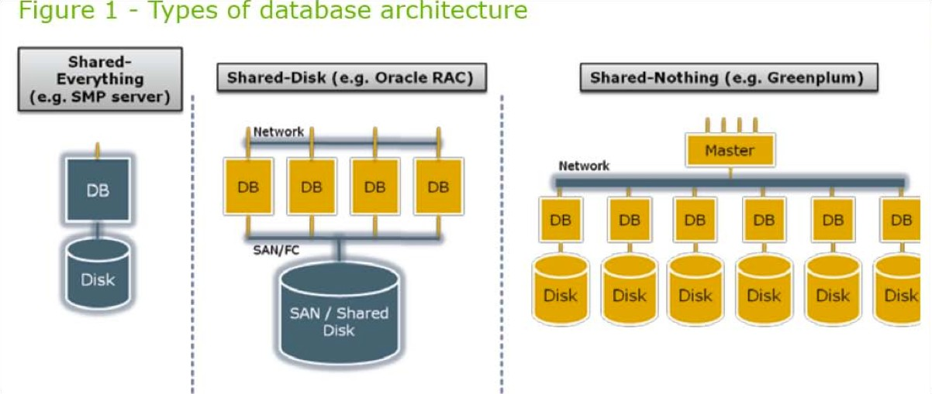
Shared Disk
All nodes access the same disks
Found in the largest "single-box" (non-cluster) multiprocessors
Traditionally: Hard to scale past a certain point
Contention on storage bandwidth
Existing deployments typically have < 10 machines
New incarnation: Running over Amazon S3 / your_cloud_service
Arbitrary scaleout (Reasons: S3 has A LOT of disks, Executors are stateless)
Single-node performance low
(SAN: “Storage Area Network”)
Source: Greenplum Database Whitepaper
Notes:
All CPUs can access a single logical disk directy via an interconnect, but each have their own private memories.
Can scale execution layer independently from the storage layer.
Have to send messages between CPUs to learn about their current state.
Examples: Presto / Impala / NuoDB / Redshift / Hortonworks Stinger / Hbase / Snowflake / Spanner / Aurora
HDFS can be thought of as a “shared-disk” backend

Slide 6
Shared Nothing
Cluster of machines on high-speed network
Called "clusters" or "blade servers”
Each machine has its own memory and disk
Note: All machines today have many cores and many disks. SN systems run many "nodes” in each machine.
Characteristics
Today, this is the most scalable architecture (lowest contention)
Most difficult to administer and tune.
(Think of rebalancing data when adding a new node!)
Source: Greenplum Database Whitepaper
Notes:
Each DBMS instance has its own CPU, memory, and disk.
Nodes only communicate with each other via network
Easy to increase capacity
Hard to ensure consistency
Examples: MongoDB / cassandra / greenplum / memsql / coucbase / vertica

Slide 7
Outline
Parallel architectures
Distributed transactions
Concurrency control
Commit
Replication
Eventual Consistency

Slide 8
Single-node vs. Distributed transactions
A single-node transaction accesses data that is contained on one data partition.
The DBMS does not need to coordinate the behavior of concurrent transactions running on other nodes
A distributed transaction accesses data at one or more partitions.
Requires expensive coordination

Slide 9
Transaction Coordination
If our DBMS supports multi-operation and distributed transactions, we need a way to coordinate their execution in the system
Two different approaches:
Centralized: Global “traffic cop”
Decentralized: Nodes organize themselves
Notes:
Now,
When multiple operations can happen on a single object at the same time, we need some coordination.
When a transaction requires coordination we can have two approaches:
A centralized one
And a decentralized one

Slide 10
Distributed Concurrency Control
Need to allow multiple transactions to execute simultaneously across multiple nodes.
Many of the protocols from single-node DBMS can be adapted
It is harder though! Reasons:
Network Communication Overhead
Clock Skew
Node Failures
Replication
Distributed 2PL:
Increased lock duration
Who detects deadlocks?
Timestamp-based:
Whose clock is correct?
Can we have 1 global clock?
Notes:
Network Communication Overhead => Increased lock duration

Slide 11
Distributed Locking
How do we manage locks for objects across many sites?
Centralized: One site does all locking.
Vulnerable to single site failure.
Primary Copy: All locking for an object done at the primary copy site for this object.
Reading requires access to locking site as well as site where the object is stored.
Fully Distributed: Locking for a copy done at site where the copy is stored.
Locks at all sites while writing an object.

Slide 12
Distributed Deadlock Detection
Each site maintains a local waits-for graph.
A global deadlock might exist even with acyclic local graphs:
T1
T2
T1
T2
T1
T2
SITE A
SITE B
GLOBAL
Three solutions: Centralized (send all local graphs to one site); Hierarchical (organize sites into a hierarchy and send local graphs to parent in the hierarchy); Timeout (abort Xact if it waits too long).
(Fourth): Abort instead of waiting for lock!

Slide 13
Distributed Transactions
Transactions in Distributed DBMS
Submitted at one site, access data from other sites
Subtransaction: part of transaction in one site
How to guarantee ACID properties?
Distributed concurrency control: How are locks managed? deadlocks detected?
Distributed recovery: How to guarantee Atomicity across sites?

Slide 14
Distributed Recovery
If sub-transactions of an Xact execute at different sites, all or none must commit.
Need a commit protocol to achieve this.
A log is maintained at each site, as in a centralized DBMS, and commit protocol actions are additionally logged.

Slide 15
Is a distributed transaction OK to commit?
When a multi-node transaction finishes, the DBMS needs to ask all of the nodes involved whether it is safe to commit.
Nodes must use an atomic commit protocol
Examples:
Two-phase commit
Three-phase commit (many assumptions; not used)
Paxos
Raft
ZAB (Apache Zookeeper)
All nodes must agree!
Notes:
To achieve this “agreement” we will concentrate on Two-phase commit

Slide 16
Two-Phase Commit (2PC)
Site at which Xact originates is coordinator; other sites at which it executes are subordinates.
When an Xact wants to commit:
Coordinator sends prepare msg to each subordinate.
Subordinate force-writes an abort or prepare log record and then sends a no or yes msg to coordinator.
If coordinator gets unanimous yes votes, force-writes a commit log record and sends commit msg to all subs. Else, force-writes abort log rec, and sends abort msg.
Subordinates force-write abort/commit log rec based on msg they get, then send ack msg to coordinator.
Coordinator writes end log rec after getting all acks.
Notes:
There are multiple types of messages
Voting:
prepare: Sent by the coordinator to the subordinates
Yes/no: sent by the subordniate to coordinator
Terminaton:
Commit/abort: sent by the coordinator to subordinates
Ack: sent by subordinates to the coordinator
Seperate the messages sent to the ones logged!

Slide 17
Comments on 2PC
Two rounds of communication: first, voting; then, termination. Both initiated by coordinator.
Any site can decide to abort an Xact. All sites much agree to commit
Every msg reflects a decision by the sender; to ensure that this decision survives failures, it is first recorded in the local log.
All commit protocol log recs for an Xact contain Xactid and Coordinatorid.
The coordinator’s abort/commit record also includes ids of all subordinates.

Slide 18
Restart After a Failure at a Site
If we have a commit or abort log rec for Xact T, but not an end rec, must redo/undo T.
If this site is the coordinator for T, keep sending commit/abort msgs to subs until acks received.
If we have a prepare log rec for Xact T, but not commit/abort, this site is a subordinate for T.
Repeatedly contact the coordinator to find status of T, then write commit/abort log rec; redo/undo T; and write end log rec.
If we don’t have even a prepare log rec for T, unilaterally abort and undo T.
Site may be coordinator. If so, Subordinates may send messages later.

Slide 19
Link and Remote Site Failures
If a remote site does not respond during the commit protocol for Xact T, either because the site failed or the link failed:
If the current site is the coordinator for T, should abort T.
If the current site is a subordinate, and has not yet voted yes, it should abort T.
If the current site is a subordinate and has voted yes, it is blocked until the coordinator responds.

Slide 20
Observations on 2PC
Ack msgs used to let coordinator know when it can “forget” a Xact; until it receives all acks, it must keep T in the Xact Table.
If coordinator fails after sending prepare msgs but before writing commit/abort log recs, when it comes back up it aborts the Xact.
If a subtransaction does no updates, its commit or abort status is irrelevant.
Notes:
Cases when a coordinator fails
And
For subtransaction of a transaction

Slide 21
2PC with Presumed Abort
When coordinator aborts T, it undoes T and removes it from the Xact Table immediately.
Doesn’t wait for acks; “presumes abort” if Xact not in Xact Table. Names of subs not recorded in abort log rec.
Subordinates do not send acks on abort.
If subxact does not do updates, it responds to prepare msg with reader instead of yes/no.
Coordinator subsequently ignores readers.
If all subxacts are readers, 2nd phase not needed.

Slide 22
2PC: Coordinator failures & Blocking
If coordinator for Xact T fails, subordinates who have voted yes cannot decide whether to commit or abort T until coordinator recovers.
T is blocked.
Even if all subordinates know each other (extra overhead in prepare msg) they are blocked unless one of them voted no.

Slide 23
The general problem: server failures
What to do when a server crashes?
Servers continuously fail in large-scale systems
Wait for recovery: too long…
Use replication!
Keep several copies the data, i.e., replica, in other servers
If a server fails, another server takes over
Also use for load balancing
Up to now: strong consistency
All copies have to have the same value
“Customer of online services will be confronted with the consequences of using replication techniques”
Notes:
Strong consistency?

Slide 24
Replication & Updating Distributed Data
Synchronous Replication: All copies of a modified relation (fragment) must be updated before the modifying Xact commits.
Data distribution is made transparent to users.
Asynchronous Replication: Copies of a modified relation are only periodically updated; different copies may get out of sync in the meantime.
Users must be aware of data distribution.

Slide 25
Synchronous Replication
Voting: Xact must write a majority of copies to modify an object; must read enough copies to be sure of seeing at least one most recent copy.
E.g., 10 copies; 7 written for update; 4 copies read.
Each copy has version number.
Not attractive usually because reads are common.
Read-any Write-all: Writes are slower and reads are faster, relative to Voting.
Most common approach to synchronous replication.
Choice of technique determines which locks to set.

Slide 26
Cost of Synchronous Replication
Before an update Xact can commit, it must obtain locks on all modified copies.
Sends lock requests to remote sites, and while waiting for the response, holds on to other locks!
If sites or links fail, Xact cannot commit until they are back up.
Even if there is no failure, committing must follow an expensive commit protocol with many msgs.
So the alternative of asynchronous replication is widely used in NoSQL systems (a.k.a eventual consistency)

Slide 27
Asynchronous Replication
Allows modifying Xact to commit before all copies have been changed (and readers nonetheless look at just one copy).
Users must be aware of which copy they are reading, and that copies may be out-of-sync for short periods of time.
Two approaches: Primary Site and Peer-to-Peer replication.
Difference lies in how many copies are ``updatable’’ or ``master copies’’.

Slide 28
Peer-to-Peer (multi-leader) Replication
More than one of the copies of an object can be a master in this approach.
Changes to a master copy must be propagated to other copies somehow.
If two master copies are changed in a conflicting manner, this must be resolved. (e.g., Site 1: Joe’s age changed to 35; Site 2: to 36)
Best used when conflicts do not arise:
E.g., Each master site owns a disjoint fragment.
E.g., Updating rights owned by one master at a time.

Slide 29
Primary Site Replication
Exactly one copy of a relation is designated the primary or master copy. Replicas at other sites cannot be directly updated.
The primary copy is published.
Other sites subscribe to (fragments of) this relation; these are secondary copies.
Main issue: How are changes to the primary copy propagated to the secondary copies?
Done in two steps. First, capture changes made by committed Xacts; then apply these changes.

Slide 30
Implementing the Capture Step
(Physical) Log-Based Capture: The log (kept for recovery) is used to generate a Change Data Table (CDT).
If this is done when the log tail is written to disk, must somehow remove changes due to subsequently aborted Xacts.
Procedural Capture: A procedure that is automatically invoked (ex: trigger) does the capture; typically, just takes a snapshot.
Log-Based Capture is cheaper & faster, but relies on proprietary log details.
Middle-ground: Logical log-based capture
[MySQL] Row-based replication: Describe edits at row granularity

Slide 31
Implementing the Apply Step
The Apply process at the secondary site periodically obtains (a snapshot or) changes to the CDT table from the primary site, and updates the copy.
Period can be timer-based or user/application defined.
Replica can be a view over the modified relation!
If so, the replication consists of incrementally updating the materialized view as the relation changes.
Log-Based Capture plus continuous Apply minimizes delay in propagating changes.
Procedural Capture plus application-driven Apply is the most flexible way to process changes.

Slide 32
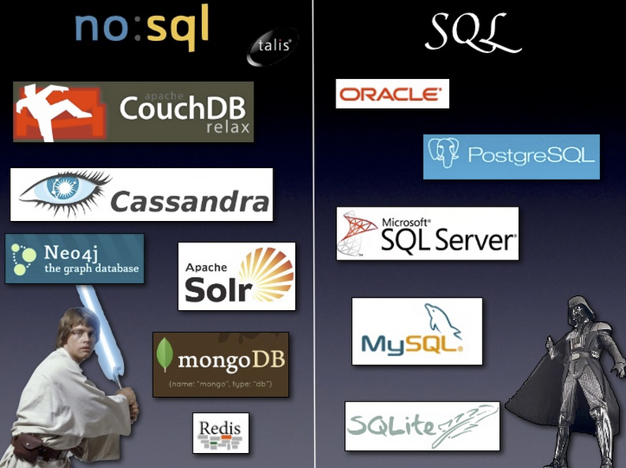
NoSQL wars: How does a system handle failures (and replication)?

Slide 33
Tracking mutable, replicated state
Replication:
Synchronous or asynchronous?
Can processes read from / write to any replica?
Process A
x ← 7
x = 5
x = 5
x = 5

Slide 34
Tracking mutable, replicated state
Replication:
Can processes read from / write to any replica?
Synchronous or asynchronous?
Process A
x ← 7
x = 7
x = 5
x = ?
x = 5
Process B

Slide 35
Tracking mutable, replicated state
Replication:
Can processes read from / write to any replica?
Synchronous or asynchronous?
Process A
x ← 7
x = 7
x = 5
x = 5
x = ?
Process B

Slide 36
Tracking mutable, replicated state
Replication:
Can processes read from / write to any replica?
Synchronous or asynchronous?
Process A
x ← 7
x = 7
x = 5
x = 5

Slide 37
CAP theorem: A reasoning tool for distributed systems
Linearizability (Not the C from ACID)!!!
(All) alive nodes can satisfy (all) requests
C
A
Consistency
Availability
Partition Tolerance
P
Impossible
Operate correctly despite message loss
How should a system behave in the presence of a network partition?
Notes:
Consistency: data are the same across all replicas in the cluster
Availability: the cluster can be still accessed even if a node goes down
Partition tolerance: the cluster can still be access even if a network link goes down
Linearizability: every read returns the most recent write

Slide 38
CAP - Consistency
If master says the txn committed, then it should be immediately visible on replicas.
Step in this direction: Synchronous replication
Process A
x ← 7
LOCK
x = 5
x = 5
LOCK
x = ?
x = 5
Process B

Slide 39
CAP - Consistency
If master says the txn committed, then it should be immediately visible on replicas.
Step in this direction: Synchronous replication
Process A
x ← 7
x = 7
x = 7
LOCK
x = 7
x = 7
Process B

Slide 40
CAP - Availability
Every request receives a (non-error) response
Without guarantee that it contains the most recent write!
Process A
x ← 7
x = 7
x = 5
x = 5
x = ?
Process B

Slide 41
CAP - Availability
Every request receives a (non-error) response
Without guarantee that it contains the most recent write!
Process A
x ← 7
x = 7
x = 5
x = 5
x = 5
Process B

Slide 42
NoSQL: From ACID to BASE
Basically Available Soft state Eventual consistency
Eventual consistency: If no new updates are made to a given data item, eventually all accesses to that item will return the last updated value
At some point, system state will converge (Merge conflicting writes)
Typically calibrate consistency degree with use of read and write quorum

Slide 43
Quora
Return the read(write) as successful only if a pre-determined number of servers agree on the same value
Assume:
N = # of servers storing the copies of the data
R = # of servers that needs to agree on a value for a read operation
W = # of servers that needs to agree on a value for a write operation
If R(W)-many servers agree on the same value, return the read(write) as successful

Slide 44
W=1, R=1
W+R <= N:
No overlap of read, write quorum
No guarantees
W < (N+1)/2:
Conflicting writes possible
W = 1:
No durability guarantees
Process A
x ← 7
x = 7
x = 5
x = 5
x = 0
Process B
Process C
x ← 0

Slide 45
W=2, R=1
W+R <= N:
No overlap of read, write quorum
No guarantees
W = 2:
Can tolerate one node failure (reg. Write Durability)
Process A
x ← 7
x ← 7
x = 7
x = 5
x = 7
x = 5
Process B

Slide 46
W=N, R=1
W+R > N:
Synchronous repl: Strong consistency guaranteed
Asynchronous: Cannot make timing assumptions
W = N:
Can tolerate node failures (reg. Availability)
Process A
x ← 7
x ← 7
x ← 7
x = 5
x = 5
x = ?
x = 5
Process B

Slide 47
W=1, R=N
W+R > N:
Synchronous repl: Strong consistency guaranteed
Asynchronous: Cannot make timing assumptions
W < (N+1)/2:
Conflicting writes possible
W = 1:
Very fast write
No durability guarantees
Process A
x ← 7
x = 7
x = 5
x = 5
Process B
x = ?

Slide 48
How to set R and W?
R = 1 or W = 1 provides the fastest response
R = N or W = N provides the slowest response
Sacrifice consistency for faster response-time by tuning R and W parameters
If read(write)-optimized, set R(W) = 1
R + W > N
Strong consistency – at least one server overlaps
(Assuming synchronous replication!)

Slide 49
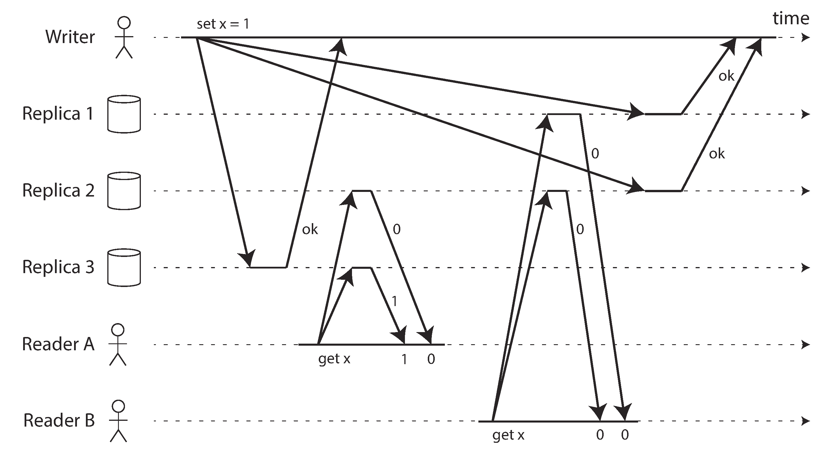
Strict quorum does NOT imply linearizability
[Source: Martin Kleppmann]
Notes:
From Designing Data-Intensive Applications. The Big Ideas Behind Reliable, Scalable and Maintainable Systems
In this Figure, the initial value of x is 0, and a writer client is updating x to 1 by sending the write to all three replicas (n = 3, w = 3). Concurrently, client A reads from a quorum of two nodes (r = 2) and sees the new value 1 on one of the nodes. Also concurrently with the write, client B reads from a different quorum of two nodes, and gets back the old value 0 from both.
The quorum condition is met (w + r > n), but this execution is nevertheless not linearizable: B’s request begins after A’s request completes, but B returns the old value while A returns the new value.
What do systems do:
Interestingly, it is possible to make Dynamo-style quorums linearizable at the cost of reduced performance: a reader must perform read repair synchronously, before returning results to the application, and a writer must read the latest state of a quorum of nodes before sending its writes. However, Riak does not perform synchronous read repair due to the performance penalty. Cassandra does wait for read repair to complete on quorum reads, but it loses linearizability if there are multiple concurrent writes to the same key, due to its use of last-write-wins conflict resolution.
Moreover, only linearizable read and write operations can be implemented in this way; a linearizable compare-and-set operation cannot, because it requires a consensus algorithm.
In summary, it is safest to assume that a leaderless system with Dynamo-style replication does not provide linearizability.

Slide 50


Slide 51
Replicated Consistency (Explained Through Football)
Concept and Slides adapted from Doug Terry

Slide 52
Data Replication in the Cloud
Question: What consistency choices should cloud storage systems offer applications?
Notes:
Virtually all cloud storage systems replicate data on multiple machines for fault-tolerance and performance. Increasingly, systems use geo-replication to survive whole datacenter loses and ensure that data is close to a globally distributed client base.

Slide 53
Strong Consistency (1)
Eventual Consistency (0)
Amazon S3
Windows Azure Storage
Amazon Simple DB
Google App Engine
Yahoo! PNUTS
Cassandra
Most systems can be toggled to “1” or “0”
Notes:
Current cloud storage systems generally choose between strong consistency and eventual consistency.
Amazon has been pushing eventual consistency, but offers strong consistency as an option in some services, like SimpleDB and DynamoDB.
Google App Engine started out offering only strong consistency, but later added the option of reading weakly consistent data for those applications that wanted better performance.
Yahoo!’s PNUTS system, which is the underlying technology for many of Yahoo’s services, conceptually offers both eventual and strong consistency, but my understanding is that the strong consistency option was never implemented.
Azure provides only strong consistency reads, although uses eventual consistency for geo-replicated data.

Slide 54
Consistency is a spectrum
Strong
Consistency
Intermediate
Consistency
Eventual
Consistency
Lots of consistency degrees proposed in research community: probabilistic quorums, session guarantees, epsilon serializability, fork consistency, causal consistency, demarcation, continuous consistency, ...
Notes:
In fact, lots of intermediate consistencies have been suggested in the research community. Most of these have not been used in commercial systems. Partly, because they are difficult to understand. Let’s look at some read consistency guarantees that I think are useful and easily described…

Slide 55
Popular Consistency Guarantees
Strong Consistency | See all previous writes.
Eventual Consistency | See subset of previous writes.
Consistent Prefix | See initial sequence of writes.
Monotonic Reads | See increasing subset of writes.
Read My Writes | See all writes performed by reader.
Bounded Staleness | See all “old” writes.
Can mix + match guarantee levels to create new ones
Notes:
Here are six consistencies that I like. Why do I like them?
1. They have simple definitions that focus on the guarantees that are provided to readers.
2. They are not tied to particular implementations or failure models.
Each of these offer different consistency/performance/availability trade-offs.
Strong consistency provides the best consistency in that is has the smallest set of allowable responses to a read request. But it also has the worse potential performance and availability.
Eventual consistency is the weakest consistency guarantee, but offers the highest performance and availability since one can read from any replica.
The other consistencies lie in between, and none is strictly better than any other.
================================
Typical way to provide stronger guarantees [Vogels]:
Whether or not read-your-writes, session, and monotonic consistency can be achieved depends in general on the "stickiness" of clients to the server that executes the distributed protocol for them. If this is the same server every time, then it is relatively easy to guarantee read-your-writes and monotonic reads.
This makes it slightly harder to manage load balancing and fault tolerance, but it is a simple solution. Using sessions, which are sticky, makes this explicit and provides an exposure level that clients can reason about.
Sometimes the client implements read-your-writes and monotonic reads. By adding versions on writes, the client discards reads of values with versions that precede the last-seen version.

Slide 56
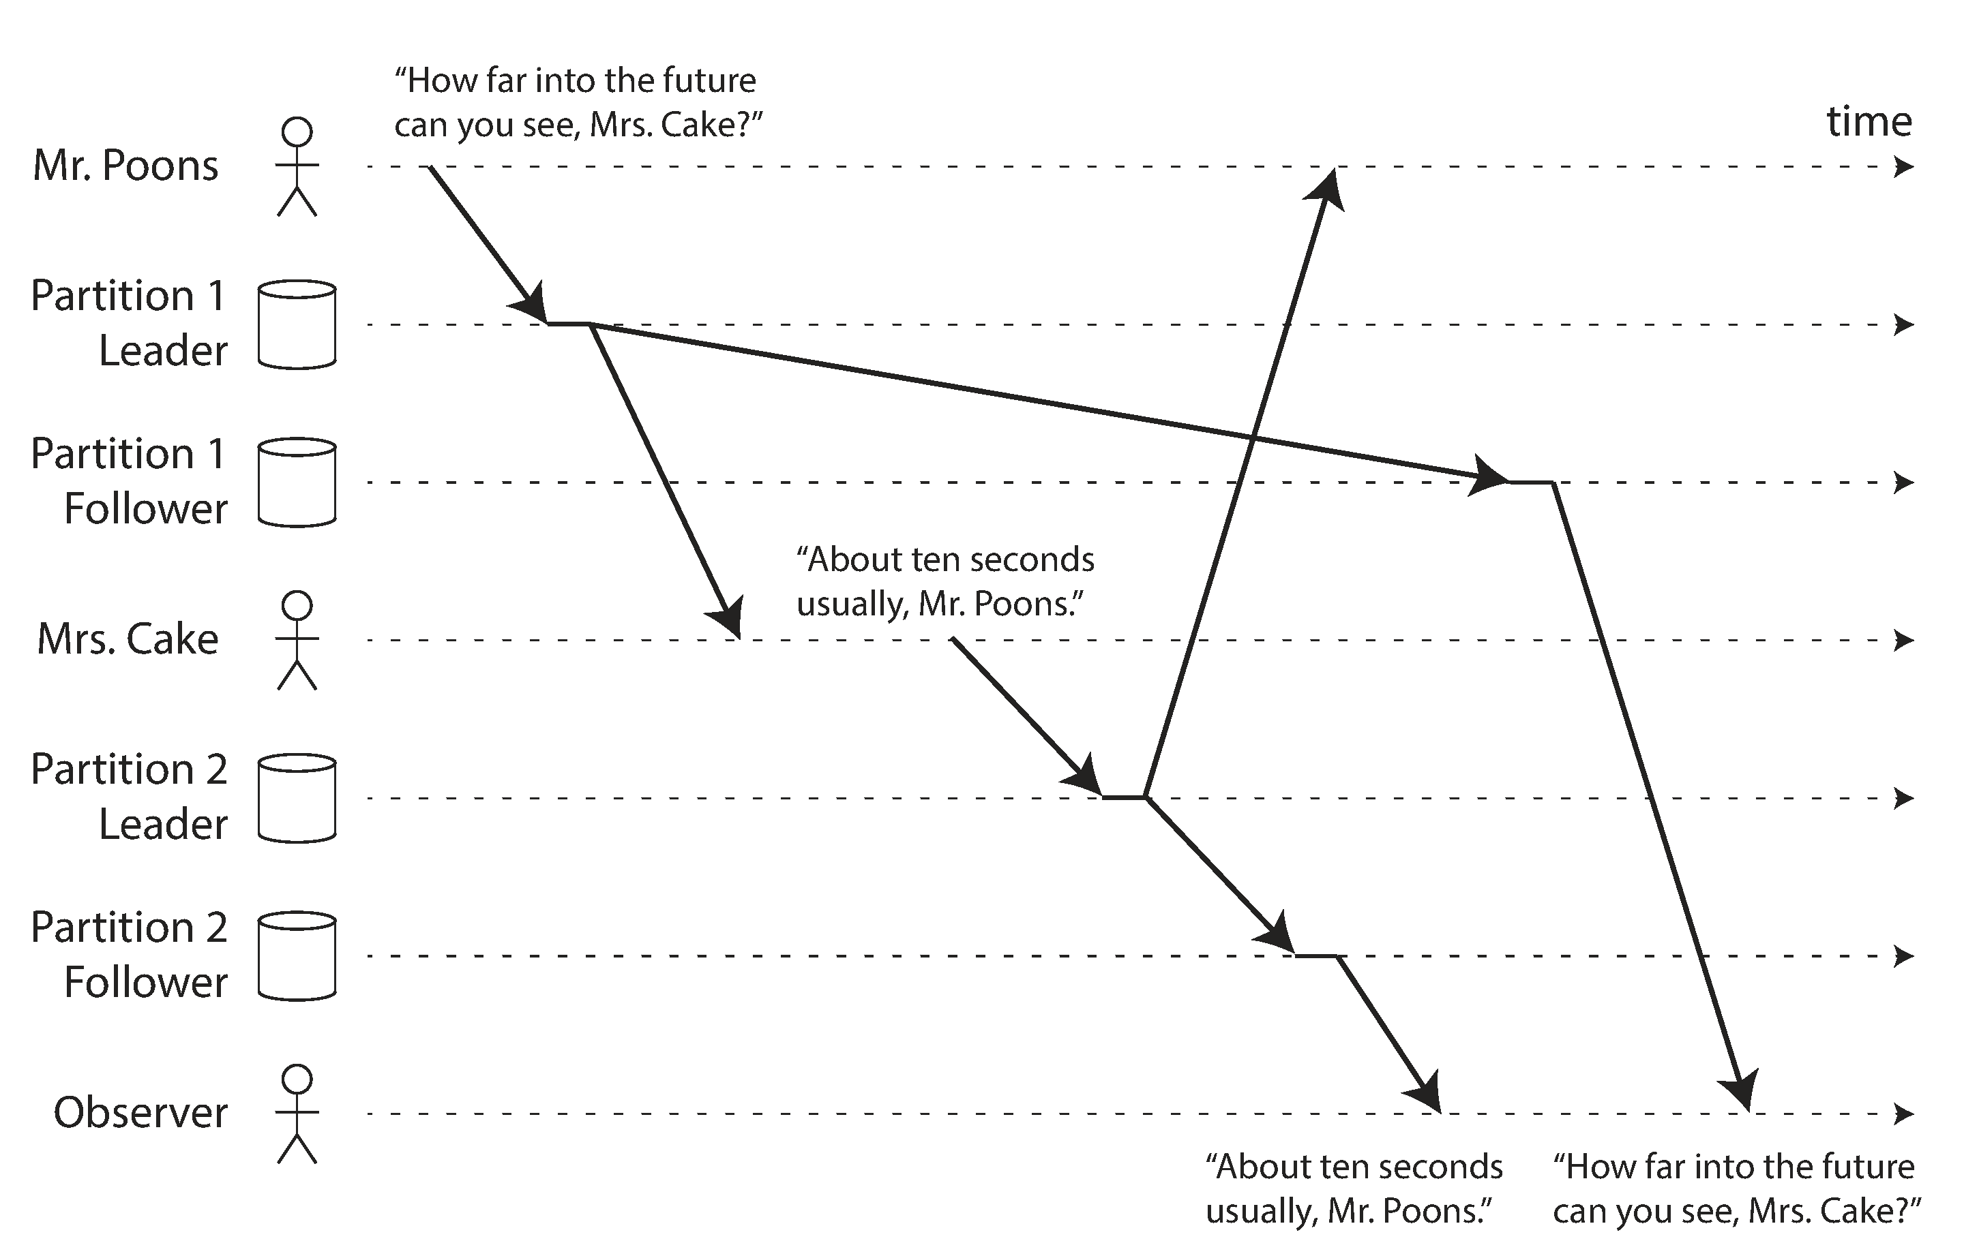
Consistent Prefix (by counter example)
[Source: Martin Kleppmann]
Fix 1: Send causally related writes to same partition (NOT CHEAP)
Fix 2: Track causal dependencies (e.g., Version Vectors)
Notes:
Typical way to provide stronger guarantees [Vogels]:
Whether or not read-your-writes, session, and monotonic consistency can be achieved depends in general on the "stickiness" of clients to the server that executes the distributed protocol for them. If this is the same server every time, then it is relatively easy to guarantee read-your-writes and monotonic reads.
This makes it slightly harder to manage load balancing and fault tolerance, but it is a simple solution. Using sessions, which are sticky, makes this explicit and provides an exposure level that clients can reason about.
Sometimes the client implements read-your-writes and monotonic reads. By adding versions on writes, the client discards reads of values with versions that precede the last-seen version.

Slide 57
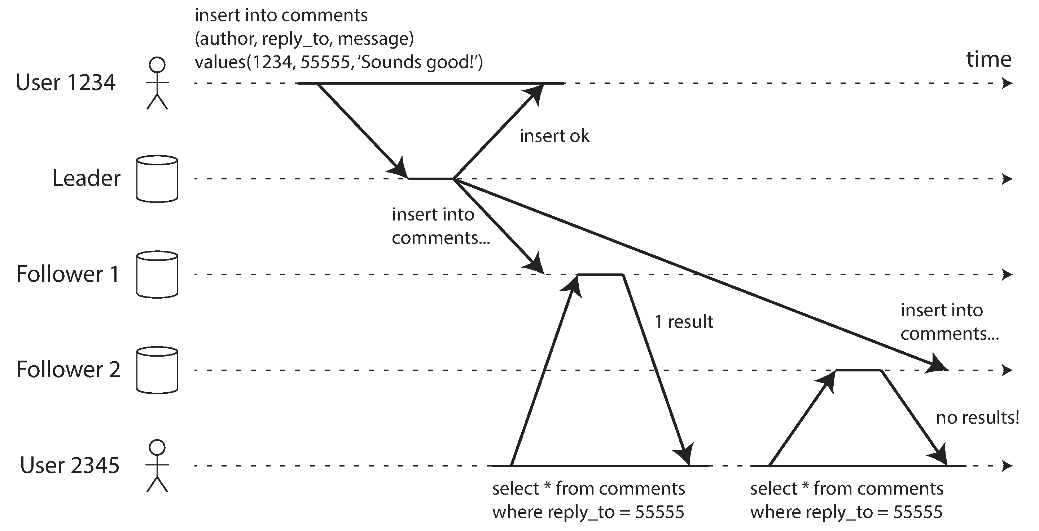
Monotonic Reads (by counter example)
[Source: Martin Kleppmann]
Fix: Always read from same replica
Notes:
Typical way to provide stronger guarantees [Vogels]:
Whether or not read-your-writes, session, and monotonic consistency can be achieved depends in general on the "stickiness" of clients to the server that executes the distributed protocol for them. If this is the same server every time, then it is relatively easy to guarantee read-your-writes and monotonic reads.
This makes it slightly harder to manage load balancing and fault tolerance, but it is a simple solution. Using sessions, which are sticky, makes this explicit and provides an exposure level that clients can reason about.
Sometimes the client implements read-your-writes and monotonic reads. By adding versions on writes, the client discards reads of values with versions that precede the last-seen version.

Slide 58
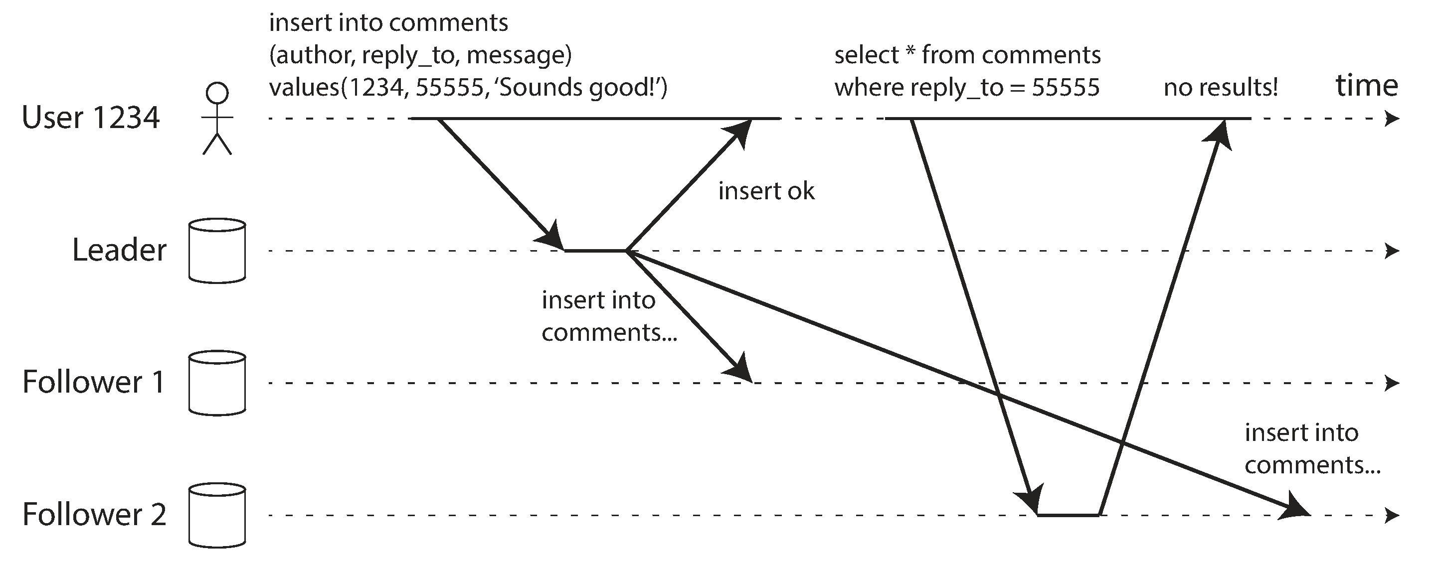
Read My Writes (by counter example)
[Source: Martin Kleppmann]
Fix 1: Client always communicates with same replica
Fix 2: Client keeps version info for its writes
Notes:
Typical way to provide stronger guarantees [Vogels]:
Whether or not read-your-writes, session, and monotonic consistency can be achieved depends in general on the "stickiness" of clients to the server that executes the distributed protocol for them. If this is the same server every time, then it is relatively easy to guarantee read-your-writes and monotonic reads.
This makes it slightly harder to manage load balancing and fault tolerance, but it is a simple solution. Using sessions, which are sticky, makes this explicit and provides an exposure level that clients can reason about.
Sometimes the client implements read-your-writes and monotonic reads. By adding versions on writes, the client discards reads of values with versions that precede the last-seen version.

Slide 59
Comparing Consistency
Strength
Strong
metric =
set of allowable read results
Prefix
Bounded
Monotonic
RMW
Eventual
Different applications / users require different guarantees

Slide 60



Real-world Example
Home
Visitors

Slide 61

The Game of Football
for half = 1 .. 2
if visitor team scores
score = Read (“visitors”);
Write (“visitors”, score + 1);
if home team scores
score = Read (“home”);
Write (“home”, score + 1);
end game;
Sample Game:
Write(“home”,1)
Write(“visitors”,1) Write(“home”,2)
Write(“home”,3)
Write(“visitors”,2)
Write(“home”,4)
Write(“home”,5)
5
2
Different spectators have different requirements

Slide 62
Official Scorekeeper (aka The Only Writer)
Guarantees
Strong Consistency
Eventual Consistency
Consistent Prefix
Monotonic Reads
Read My Writes
Bounded Staleness
Desired consistency?
Strong
= Read My Writes!
score = Read (“visitors”);
Write (“visitors”, score + 1);
Current Score:
5
2
Read My Writes | Writer: 5 - 2
 | Rest: 0-0, 1-0, 2-0,3-0,4-0,5-0,0-1,1-1,2-1,3-1,4-1,5-1,0-2,1-2,2-2,3-2,4-2,5-2
Notes:
The official scorekeeper updates a team’s total score whenever that team scores a run. She needs to see strongly consistent data, or she might write the wrong score. But since she is the only person who performs writes, the read my writes guarantee is sufficient. This may seem like a subtle distinction, but it could have significant performance consequences. In particular, the scorekeeper could likely read from any replica, especially if the time is large between runs.

Slide 63
Referee
Guarantees
Strong Consistency
Eventual Consistency
Consistent Prefix
Monotonic Reads
Read My Writes
Bounded Staleness
if end of 2nd half then vScore = Read (“visitors”);
hScore = Read (“home”);
if vScore == hScore
start overtime();
else
end game;
Desired consistency?
Strong Consistency
Current Score:
5
2
Strong Consistency | 5 - 2
Notes:
The referee only cares about the score at one point in the game: when the 2nd half is over. The referee needs strong consistency to determine if overtime needs to be played.

Slide 64
Radio Reporter
Guarantees
Strong Consistency
Eventual Consistency
Consistent Prefix
Monotonic Reads
Read My Writes
Bounded Staleness
Desired consistency?
Consistent Prefix
AND Monotonic Reads
(or Bounded Staleness)
do { vScore = Read (“visitors”);
hScore = Read (“home”);
report vScore and hScore
sleep(30 minutes);
}
Current Score:
5
2
Consistent Prefix | 0-1, 1-0, 1-1, 2-1, 3-1, 3-2, 4-2, 5-2
Monotonic Reads | (after 3-1): 3-1, 4-1, 5-1, 3-2, 4-2, 5-2
Notes:
Suppose the home team scores twice to go ahead 2-0. The visiting team then scores once to make it 2-1.
The reporter may read the visiting team’s score as 1, and then read the home team’s score as 1. And report that game as being tied. When, in fact, the game was never tied! Need a consistent prefix.
Next time, the score may be reported as 1-0. Which looks like some team lost a run! Need monotonic reads.

Slide 65
Sportswriter
Guarantees
Strong Consistency
Eventual Consistency
Consistent Prefix
Monotonic Reads
Read My Writes
Bounded Staleness
Desired consistency?
Eventual?
Strong = Bounded Staleness
while not end of game { drink beer;
eat hotdog;
}
go out for dinner;
vScore = Read (“visitors”);
hScore = Read (“home”);
write article;
Notes:
If the writer takes an hour to eat dinner, then eventual consistency is probably good enough but not guaranteed.

Slide 66
Statistics Writer
Guarantees
Strong Consistency
Eventual Consistency
Consistent Prefix
Monotonic Reads
Read My Writes
Bounded Staleness
Desired consistency?
Strong (1st read)
Read My Writes (2nd)
wait for end of game;
score = Read (“home”);
stat = Read (“season-goals”);
Write (“season-goals”,stat+score);
Notes:
Wants strong consistency for both reads, but only needs to perform a strong read in the first case since he did not write that data.

Slide 67
Casual Fan
Guarantees
Strong Consistency
Eventual Consistency
Consistent Prefix
Monotonic Reads
Read My Writes
Bounded Staleness
Desired consistency?
Eventual
do {
stat = Read (“season-goals”);
argue with friends reg. stat; sleep(1 day);
}

Slide 68
Consistency Trade-offs
performance
consistency
availability
Strong Consistency | See all previous writes.
Eventual Consistency | See subset of previous writes.
Consistent Prefix | See initial sequence of writes.
Bounded Staleness | See all “old” writes.
Monotonic Reads | See increasing subset of writes.
Read My Writes | See all writes performed by reader.
A | D | F
D | A | A
C | B | A
B | C | D
C | B | B
C | C | C
Notes:
Here are six consistencies that I like. Why do I like them?
1. They have simple definitions that focus on the guarantees that are provided to readers.
2. They are not tied to particular implementations or failure models.
Each of these offer different consistency/performance/availability trade-offs.
Strong consistency provides the best consistency in that is has the smallest set of allowable responses to a read request. But it also has the worse potential performance and availability.
Eventual consistency is the weakest consistency guarantee, but offers the highest performance and availability since one can read from any replica.
The other consistencies lie in between, and none is strictly better than any other.
---------------
CP can be implemented in distributed fashion. You do need more state, but it does not enforce “stickiness”

Slide 69
Conclusions
Consistency is a spectrum
Replication schemes involve tradeoffs between consistency, performance, and availability
Consistency choices can benefit applications
Notes:
Not one best replication scheme.
Developers can choose based on application semantics, user expectations, etc.
Can do better than eventual consistency; and better than strong consistency
Tools for predicting performance for a selected consistency
e.g. incorporating consistency and performance in SLAs

Slide 70
Backup Slides

Slide 71
Example system: Dynamo
Amazon’s e-commerce platform
Simple key-value data model
Simple get()/put() interface
Eventually consistent
Serves tens of millions customers using tens of thousands of servers located in many data centers around the world

Slide 72
Dynamo’s eventual consistency algorithm
Keep updates as separate versions of the data
Return all the versions in case of conflict
R = 2
W = 1
Process A
Process B
x₀ = 5
x₀ = 5
R = 2, success
R = 2, success
x_{A} = 7
x_{B} = 9
x₀ = 5
x₀ = 5
x₀ = 5
x₀ = 5

Slide 73
Dynamo’s eventual consistency algorithm
Keep updates as separate versions of the data
Return all the versions in case of conflict
R = 2
W = 1
Process A
Process B
W = 1, success
W = 1, success
x₀ = 5
x₀ = 5
x_{A} = 7
x_{B} = 9

Slide 74
Dynamo’s eventual consistency algorithm
Keep updates as separate versions of the data
Return all the versions in case of conflict
R = 2
W = 1
Process C
R = 2, conflict!
x₀ = 5
x₀ = 5
x_{A} = 7
x_{B} = 9

Slide 75
Dynamo’s eventual consistency algorithm
Keep updates as separate versions of the data
Return all the versions in case of conflict
R = 2
W = 1
Process C
x_{C} = 11
x_{A} = 7
x_{B} = 9
R = 2, reconcile
x₀ = 5
x₀ = 5
x_{A} = 7
x_{B} = 9

Slide 76
Dynamo’s eventual consistency algorithm
Keep updates as separate versions of the data
Return all the versions in case of conflict
R = 2
W = 1
Process C
W = 1, success
x_{C} = 11
x₀ = 5
x_{B} = 9
x_{A} = 7
x_{A} = 7
x_{B} = 9

Slide 77
Dynamo’s eventual consistency algorithm
Keep updates as separate versions of the data
Return all the versions in case of conflict
R = 2
W = 1
x_{C} = 11
x₀ = 5
x_{B} = 9
x_{A} = 7
x_{A} = 7
x_{B} = 9
Updates propagate later on internally
Eventually, data become consistent
Notes:
Potential question: what if the list of versions blow up
Answer: reconcilation ignores the versions that are completely overwritten. In our example, the first set of updates of Process A and Process B, x₀ has been ignored, since x_{A} and x_{B} have completely overwritten it. Dynamo paper says that this problem has not been surfaced in production (see Section 4.4, last paragraph).

Slide 78

An example use-case: shopping cart
Closed the web-browser and re-opened it
Shopping cart
Pair of shoes
A sun-glass
A book
A towel
Stale
Stale
Pair of shoes
A sun-glass
A book
A towel
Pair of shoes
A book
Pair of shoes
A towel

Slide 79
An example use-case: shopping cart
Closed the web-browser and re-opened it
Shopping cart
Pair of shoes
A book
A towel
Re-accessed shopping cart (assume R = 2)
Reconcile
Result is still meaningful
Application category can tolerate inconsistency
Stale
Stale
Pair of shoes
A sun-glass
A book
A towel
Pair of shoes
A book
Pair of shoes
A towel
Can all application categories tolerate inconsistency?
How about your bank account?

Slide 80
Summary: Eventual consistency
Data will eventually be consistent
(if no further updates are made)
Reads and writes need to agree on a value over a set of servers
Example system: Dynamo
Keep every update as a separate version
Merge all versions in case of conflict

Slide 81


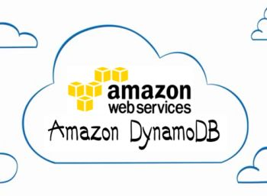

Who uses it?
Large-scale systems
Facebook, Google, Amazon, etc.
Simple key-value data model
Simple get()/put() interface

Slide 82


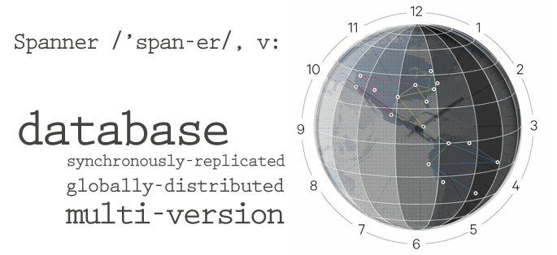

What is the downside?
Programming eventually consistent systems is very hard and error-prone
Programmers need to reconcile all the corner cases in the application to ensure correctness
Many companies go back to strong consistency
Eventually consistent
Consistency within
entity groups
Strong consistency
SQL RDBMS

Slide 83


Centralized Coordinator
P1
P2
P1
Coordinator
P2
P3
P4
P3
P4

